Slide 1

Mobile banking application using two factor authentications
IFSC 3360: System Analysis and Design
Divyajitsinh Mahida

Slide 2
System Description
Brief description of the system : So many of the peoples have a bank account in an android or an IOS phone. The idea here is, whenever a user enters in Mobile App of bank, he/ she has to enter login id and password with one more security label as Capture his/her picture. Then the picture is to be send to the database of the bank then confirmation to the login page and to the bank will be generated and if valid, user will get enter in the app otherwise it shows message that you are not authorized user try again.
Goals and objectives: Major concern related to existing Mobile Banking application is “How to make Application Secure?” So as per Security is concern, we need to provide proper Authentication which is always costlier and major security flaw in the system. So, idea here is to implement security to the Mobile Application by capturing the user image and validating with the database to ensure the authentication of the process. This way your face can only open the app.
Are you improving an existing system or designing a brand-new system? : I am improving the existing system. I do have knowledge about IOS face is security, but my idea is to capture the user photo. The application will capture the photo every time you try to login for the authorization.
Why? : Because now days so many people are hacking into bank application to steal their money. Right now the bank application is not that safe, but if we apply the photo security, it can improve the safety and security of your money.

Slide 3
System Requirements
The system shall do
- The system will capture the user photo every time whenever they try to login there bank mobile application, and that photo will go to bank database to verify the user photo. If the photo matches, the app will let the user in.
- Most importantly in this kind of authorization no one will able to hack or fraud the system with the other faces.
After looking at the bank database the system will allow you to login in the bank mobile app.
Every time this photo two factor authentication will require to login in to bank mobile application.

Slide 4
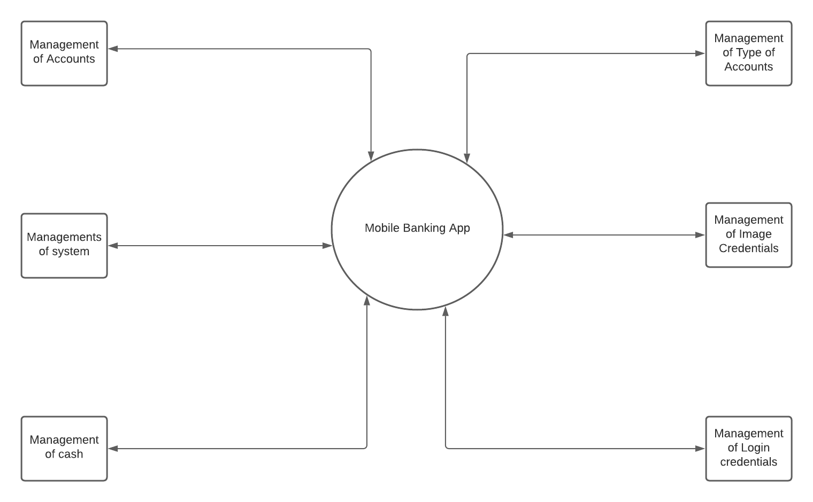
DFD Diagrams
The use case model captures the requirements of a system. Use cases are a means of communicating with users and other stakeholders what the system is intended to do Actors.

Slide 5
Use Case Model
Here there are three actors namely: 1) Mobile Phone, 2) Customer, 3) System Admin
Mobile Phone takes care of “Take Image” system use case.
While Customer and System Admin must interact co – operatively in other use cases for a smooth experience.

Slide 6
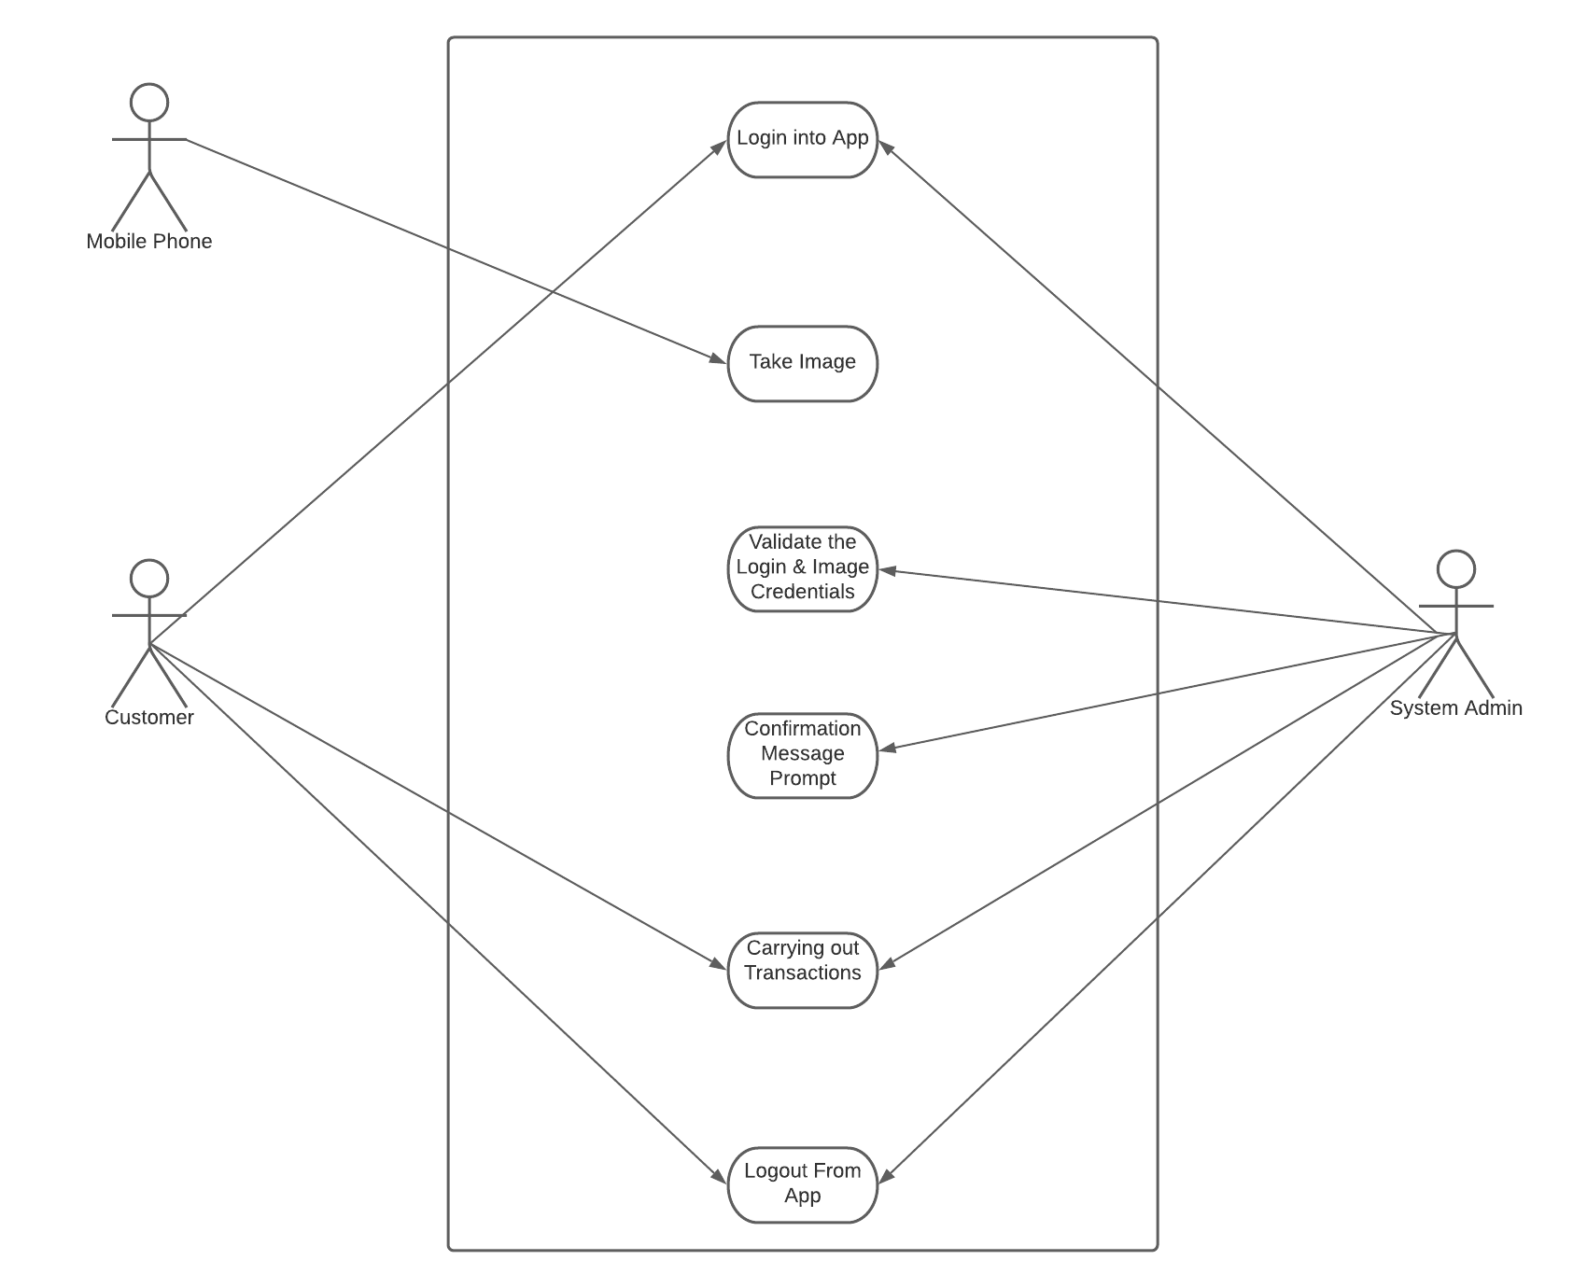
Use Case Model

Slide 7
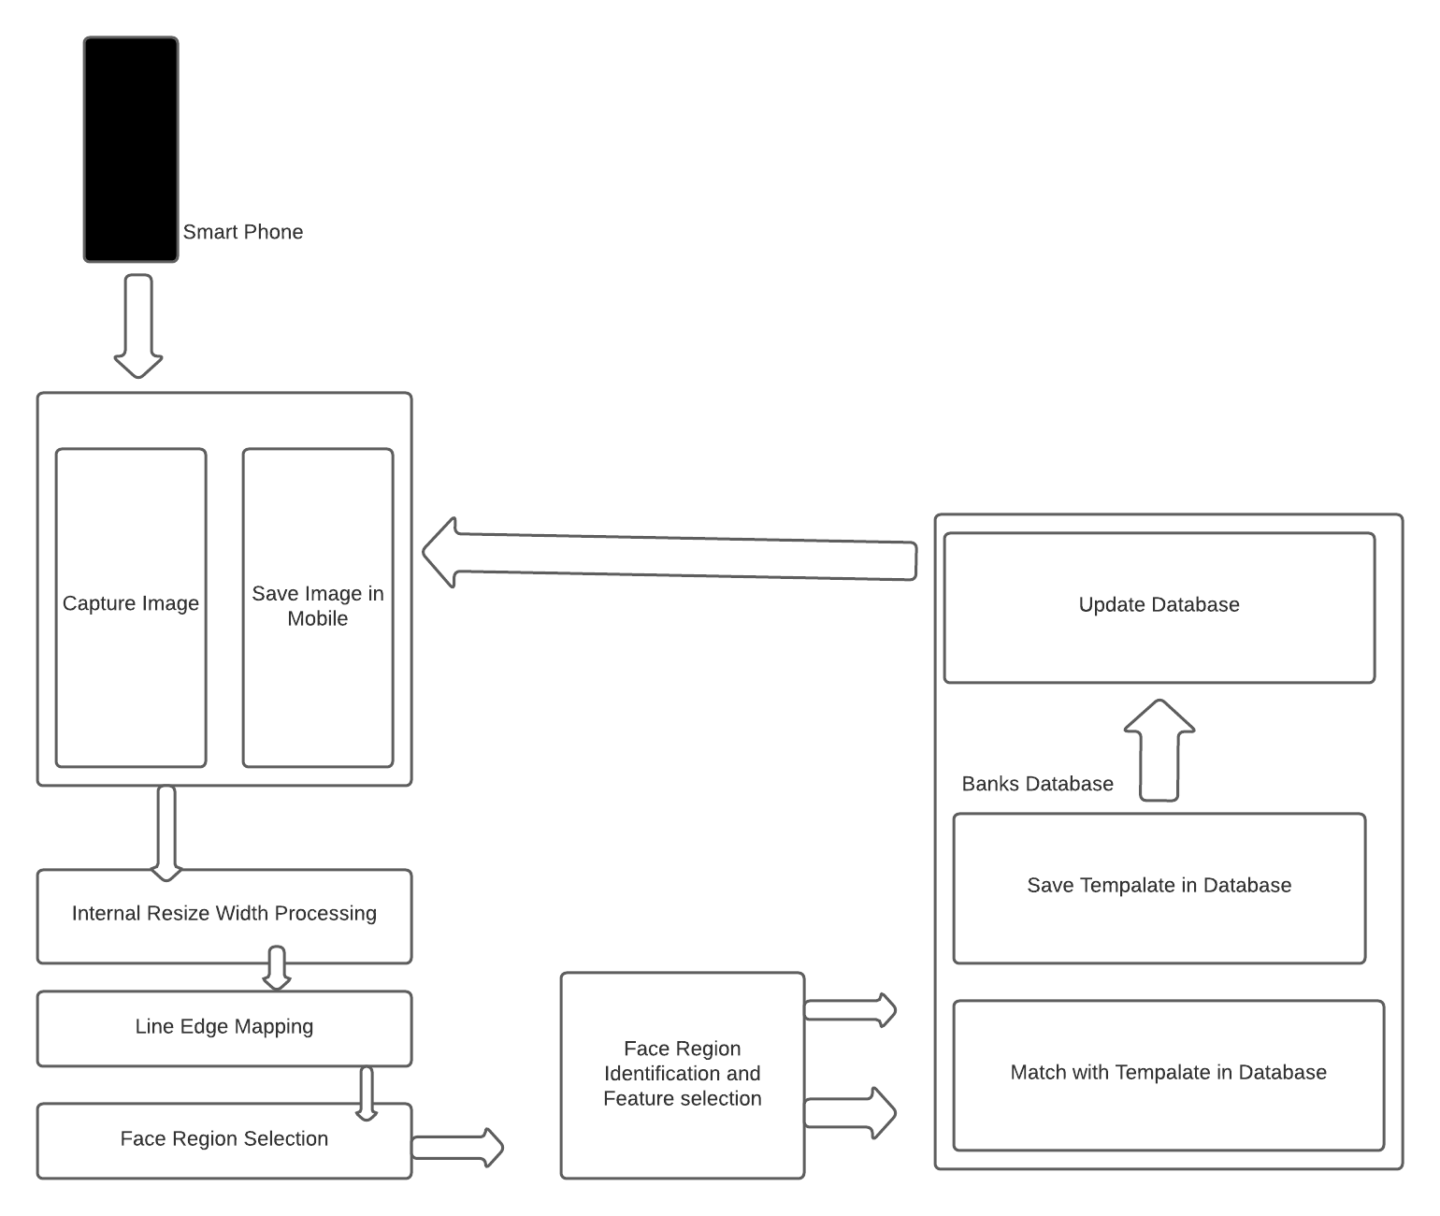
Interaction Diagrams

Slide 8
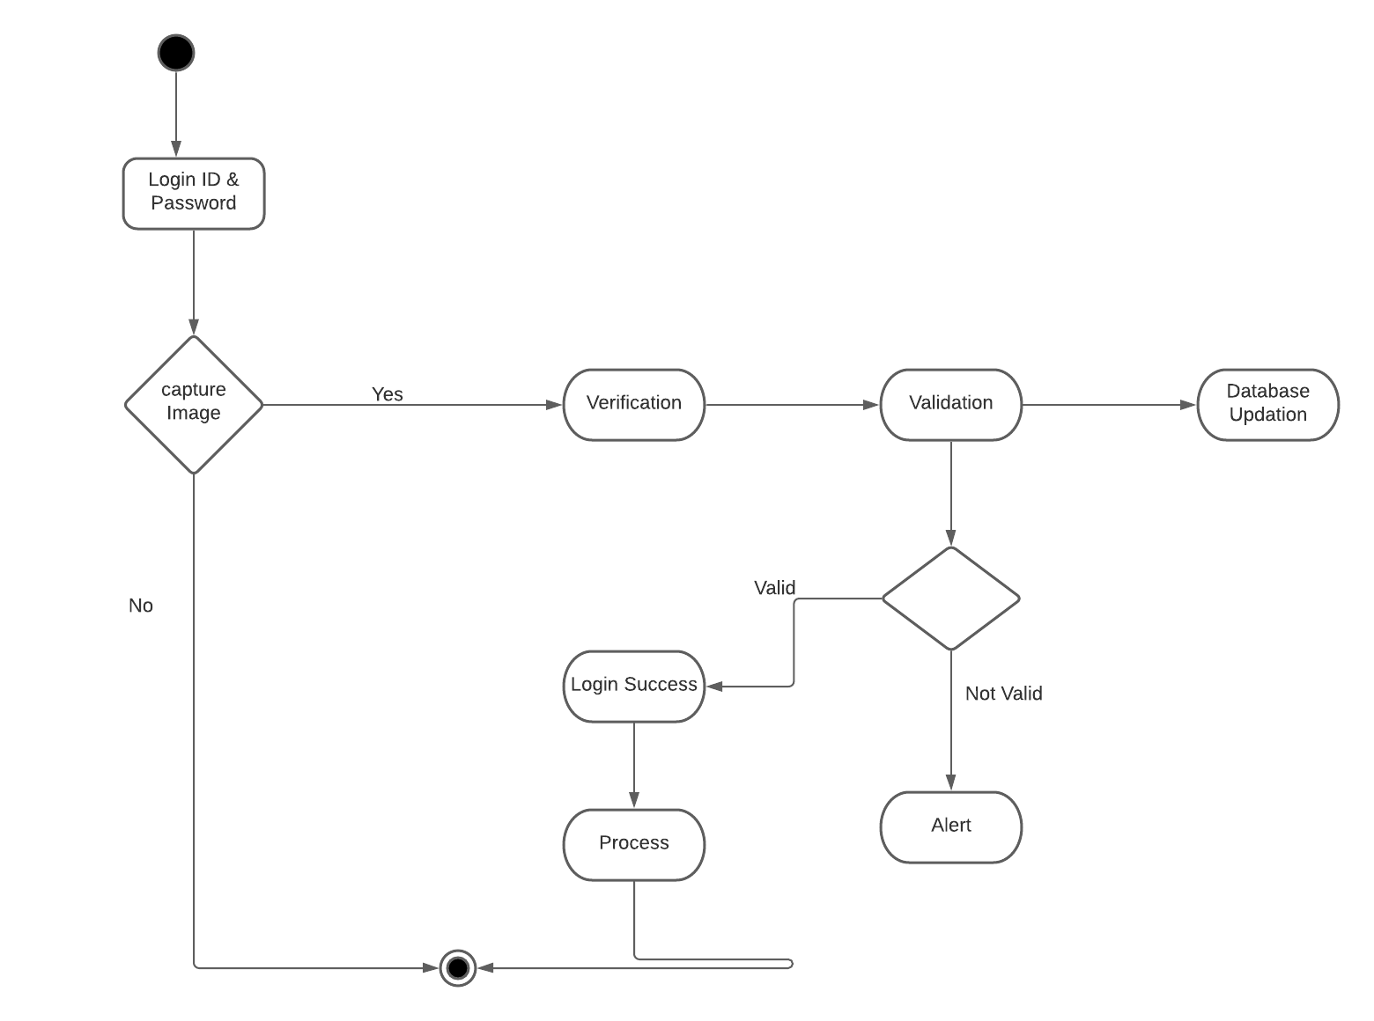
Sequence Diagram

Slide 9
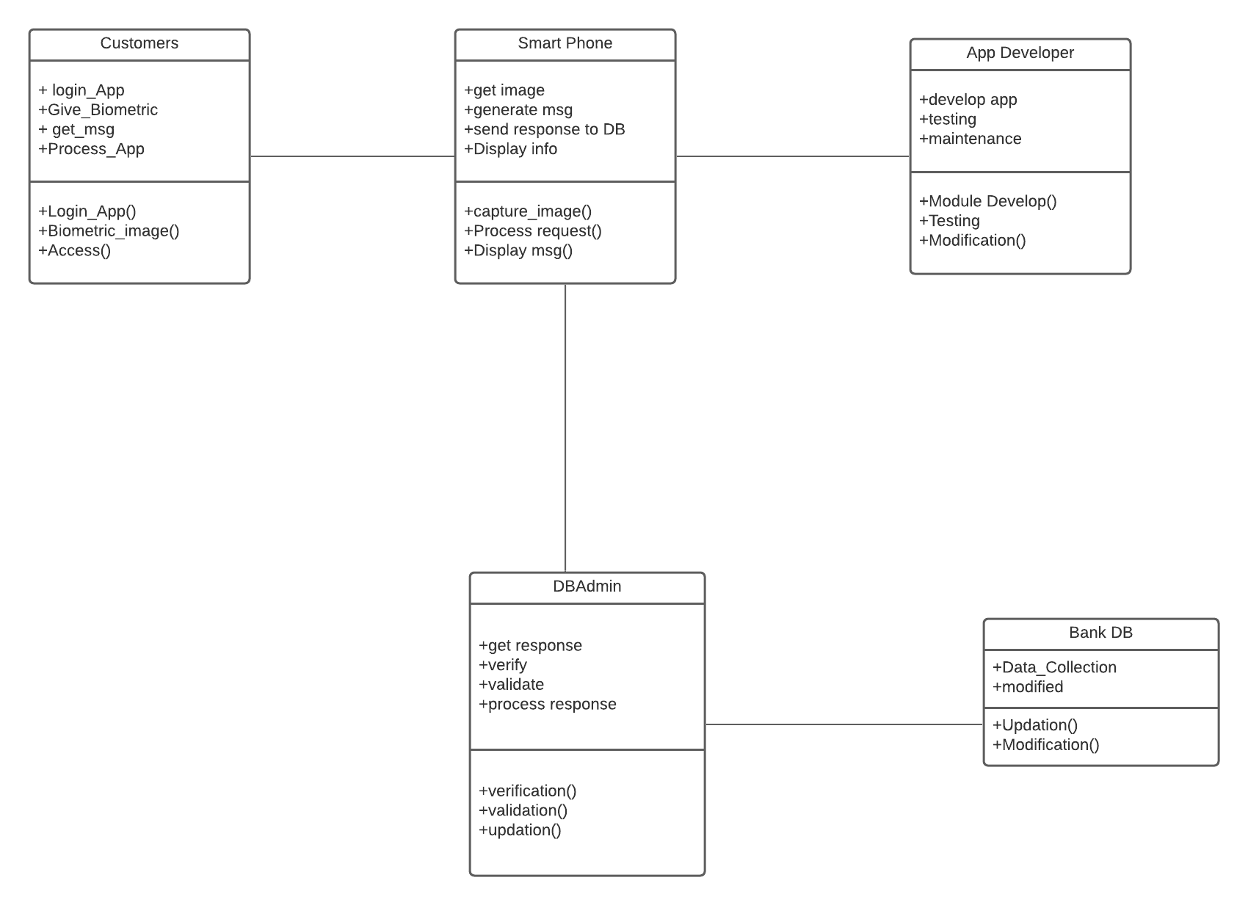
Class Diagram

Slide 10
Lessons Learned
What would you do differently, if you had another shot at the project?
- If I had another shot at this project, I would have added retina scan in the bank mobile application. Because it is scientific prove that all the humans have different retina. So I would like to add retina scan as the security. I would have added word file of the diagrams which would be clear and easy to see.

